Slide 1
OVERVIEW All About Our Project

Slide 2
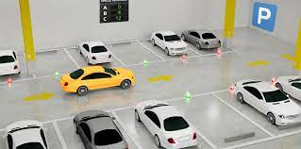
AUTOMATIC PARKING SYSTEM

Slide 3
CONTENTS
INTRODUCTION
PROBLEM STATEMENT
DESIGN APPLICATION
DESING PLAN
WORKING PROCESS
OUR PROGRESS
IDEATION PROCESS
FUTURE PLANS
RESEARCH PAPERS
CONNECTIONS
COMPONENTS USED
COST ANALYSIS
SOFTWARE USED
REFERENCE
PROTOTYPE

Slide 4
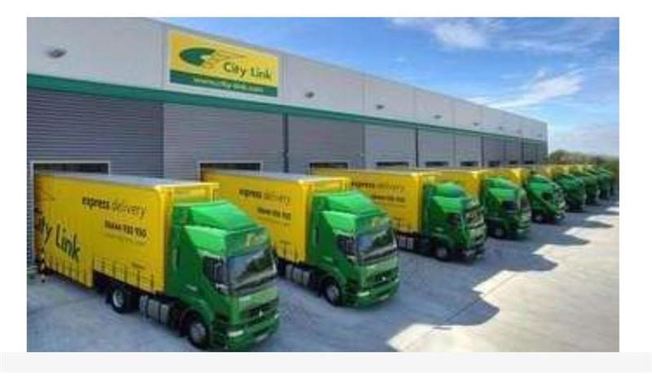
introduction
The automatic vehicle parking reservation system. It is a system that enables customers/drivers to overview a parking space. It allows the customers/drivers to view the parking status on display. the idea is developed because of the congestion and collision of the vehicle, the system will be developed for underground parking in buildings of malls and apartment Therefore the project aimed at solving such problems by designing an automatic based system that will enable the customers/drivers to make a reservation of available parking space at the parking area.

Slide 5
Problem statement
To make an automatic car parking system to save the time of users.
The main problems are the increasing number of vehicles and the decreasing efficiency of modern busy parking lots are:
1. Valuable time wasted from inconvenient and inefficient parking lot
On average, 3.5 - 12 minutes spent waiting for a spot in urban parking lots
2. More fuel consumed while idling or driving around parking lots, leading to
more CO2 emissions being produced
Average CO2 produced per car per day = .14 kg CO2
14kg for 1000 cars per day and 5110kg per year just for 1000 cars!!
3. Potential accidents caused by the abundance of moving vehicles in disorganized parking lots
2/3 of traffic accidents in parking lots involve only 1 moving vehicle
1/3 of these accidents involved 2 moving vehicles

Slide 6
Design Application
Over the decades with the development of our country we’ve reached in a situation where the manual car parking system in commercial spaces needs to be replaced. The manual car parking system is causing hurdle and chaos in parking space, therefore resulting in wastage of time and some economic losses as well. Therefore introducing Automated Car Parking Systems in commercial spaces can be replacement to the manual car parking systems at commercial spaces. We can install this system in the places like-
Office buildings, Shopping malls, Hospitals, Amusement Parks, Theaters ETC.

Slide 7
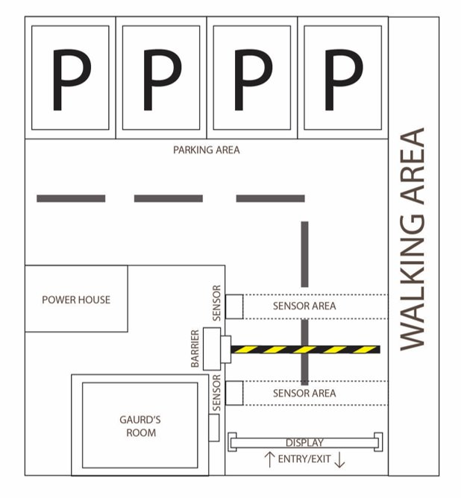
Design plan

Slide 8
Working process
ENTRY
1st IR Sensor scanning
Barrier opens
2nd IR sensor scanning
Info updates on display

Slide 9
Our progress
Our Main reason behind doing this project is in todays world’s We human are facing many problems :
Smarts parking will allow you to see where you can park your car, and at what time it is the busiest.
Smart parking will reduce search traffic on the streets…Therefore there are fewer traffic jams, and drivers will benefit by having less traffic on the streets.

Slide 10
Ideation process
Looking over the problem statements we made an concept called ( Fully automated parking systems operate much like robotic valet parking).
The driver drives the car into an APS entry(transfer) area...The driver retrieves a car by inserting a ticket or code into an automated terminal. The APS lifts the car from its parking space and delivers it to an exit area.

Slide 11
FUTURE PLANS…
If our concept success then we will go for the Company’s automated parking system uses lasers to scan cars and a robotic valet to park the vehicles.
Vehicles are transported by a robotic dolly that lifts and transfers them to storage racks.
Using this system, up to 4 times as many cars can be parked in the same amount of space as a traditional garage.

Slide 12
PRESENTATION 2 Research Papers And progress
.

Slide 13
CONRIBUTIONS
Pollution caused by parking lots by Priyanka kumari
Accidents caused by parking lots by Sanket Satone
Solar electricity (future upgrades) by Someshwar ware
Components and connections (model) by Ritik Raj

Slide 14
Pollution caused by parking lots
.

Slide 15
.
Energy production and use (including fuels used by vehicles) were the largest sources of greenhouse gas emissions in 2010 – a whopping 71% of the total.
According to WHO, Delhi houses the world’s most polluted air with small particulate matter six times the safe level. India is also believed to have the world’s highest death rate from chronic respiratory diseases.
Vehicles that move at a high speed emit less amount of toxins but due to lack of space, traffic jams have become the order of the day. Toxins are thus emitted at a higher level as most motorists leave their vehicle engines on even when they are stuck in traffic, often caused by other motorists looking for parking.
Through parking data, smart parking systems also enable city administrations to access crucial data to pave the way for cleaner environments. However, such benefits are unlikely to occur with outdated infrastructure in place and disconnected systems that can’t communicate with each other.
By leveraging IoT, smart parking easily solves this problem. Additionally, by implementing dynamic pricing based on available space, smart parking can significantly reduce congestion and overuse of parking lots, thus impacting air and noise pollution.

Slide 16
Accidents caused by parking lots
.

Slide 17
.
Drivers may be distracted by a variety of factors, including stressful errands, noisy children, or their own cell phones
It is estimated that around 20% of all reported vehicle accidents occur in parking lots.
Admittedly, most parking lot accidents happen at low speeds. However, accidents are much more serious when pedestrians are involved, which, in parking lots, is common.
For the most part, parking lot accidents are not radically different from other types of car accidents, but there are a few important distinctions.

Slide 18
*Parking Safety Tips*:
The following strategies for safe parking have been compiled from industry and insurance studies.
Stay alert and scan the area. Use your mirrors or rear-view cameras.
Look for pedestrians.
Drive slow. Obey posted speed limits and signs.
Wear your seat belt.
When parking, keep distance between your vehicle and others.
Reverse park into the parking space.We encourage everyone to exercise forward-first parking. Taking the time to back into a sure-safe parking stall is a small lifestyle change that could prevent an accident and could save a life.

Slide 19
Solar electricity (future upgrades)
.

Slide 20
.
Today this system works on electricity, but in future we can connect solar panel, solar panel converts solar energy into electrical energy and system will be working on solar.
We can convert solar energy into electrical energy by following methods:
A)photovoltaic or pv solar technology
B)solar thermal technolgy
Indian market survey hold by many researchers says that demand for electric vehicle is increasing so we need to prepare for mass production of these charging stations. We should plant these charging stations in automatic parking stations which runs on solar electrical power.
in future we can upgrade another feature is We can shade our automatic parking system by solar panels.In that we can convert our parking system into solar roof parking. In many shopping malls and retail stores which have open parking lots with no shades or protection, solar parking can be a good way to protect the car from the sun and produce clean and free solar electricity.

Slide 21
Components and connections
.

Slide 22
ARDUINO UNO
The Arduino Uno is a microcontroller board which is widely used among various other Arduino boards. The uno is the latest in a series of USB arduino boards and the reference model for Arduino platform. This microcontroller board is based on the ATmega 328. There are 14 digital input/output pins, out of which 6 can be used as PWM outputs. The microcontroller board also has 6 analog inputs, a 16MHz crystal oscillator, a USB connection, a power jack, an ICSP header and a reset button.
Arduino boards are available with many different types of built-in modules in it example
Arduino Wireless shield:
Arduino Motor Driver Shield:
Arduino Ethernet shield:

Slide 23
.
IR PROXIMITY SENSOR
Ir proximity sensor is widely applied in portable devices such as mobile phones, PDAs . It adopts photodiode which is compatible with CMOS process
the IR proximity sensor works under the condition of sunlight and background lights, reflected signals of tested content
SERVO MOTOR
It is a control motor that effectively controls position, speed, acceleration and torque by controlling the movement of mechanical equipment in the servo structure.
the function of an AC servo motor is to convert the received voltage signal into a specific speed or angular displacement of the motor,

Slide 24
.
DISPLAY
A liquid crystal display (LCD) is a thin, flat electronic visual display that uses the light modulating properties of liquid crystals (LCs). LCs does not emit light directly.
16×2 LCD is named so because; it has 16 Columns and 2 Rows. There are a lot of combinations available like, 8×1, 8×2, 10×2, 16×1, etc. But the most used one is the 16*2 LCD, hence we are using it here.

Slide 25
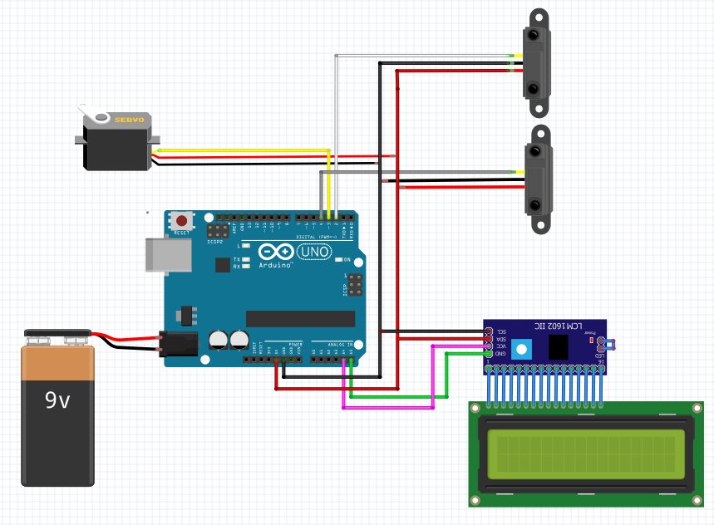
connections
.
IR proximity sensors
Servo motor
Arduino uno
16x2 LCD display
Battery

Slide 26
Presentation 3 Progress On Model
,

Slide 27
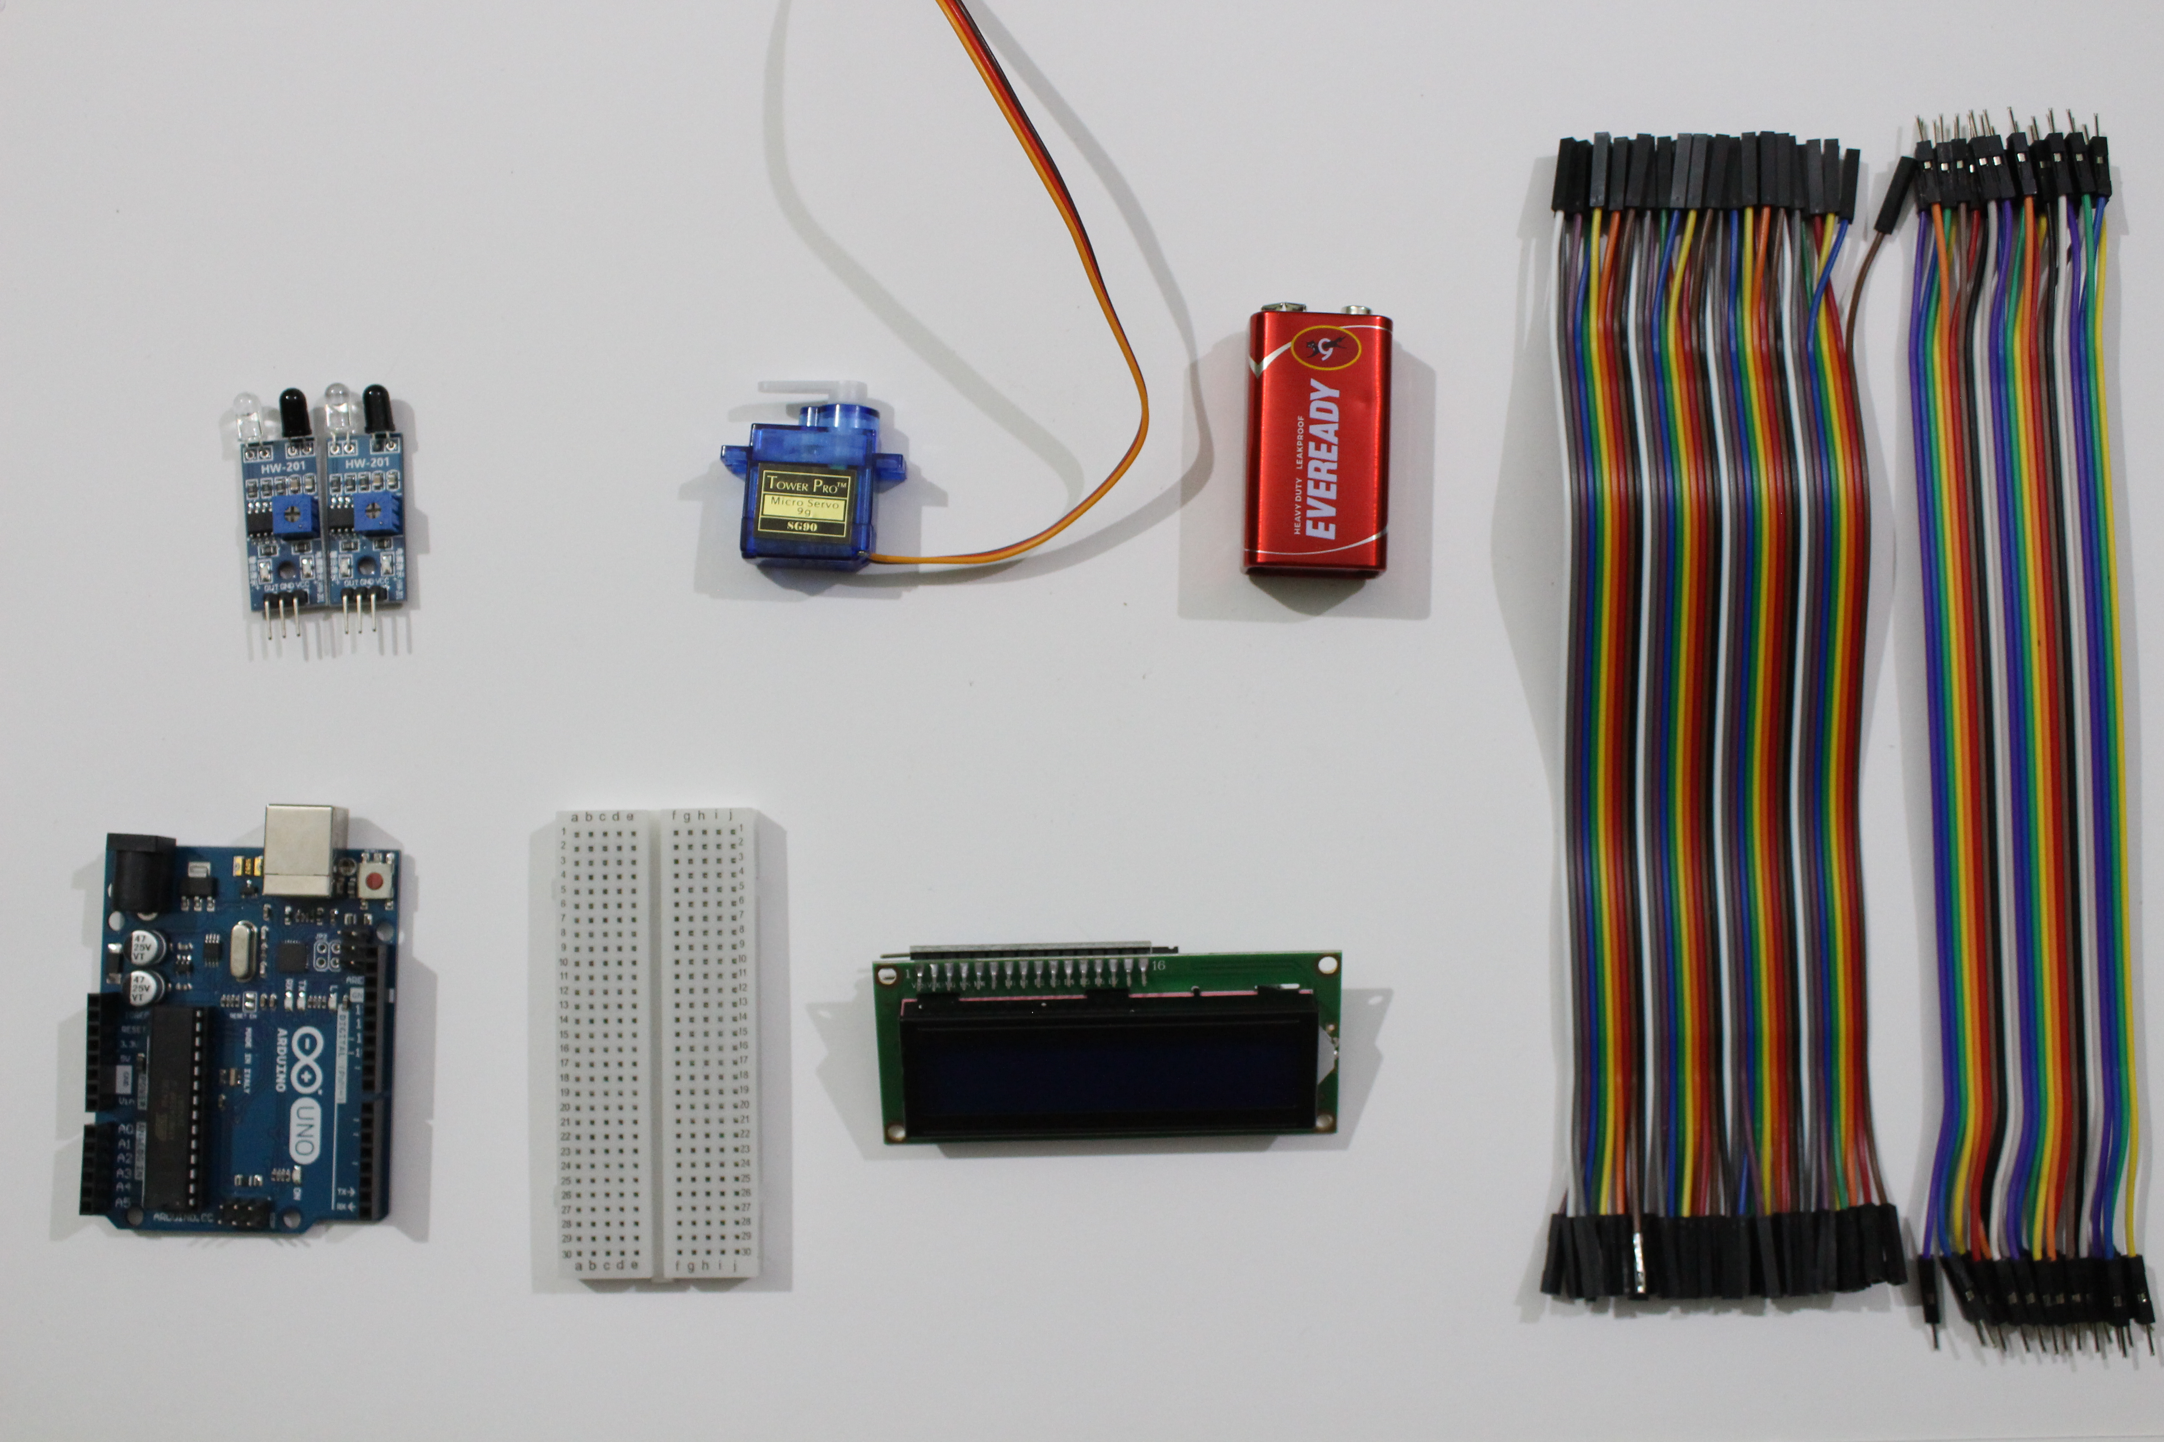
Components we used
IR PROXIMIY SENSOR
SERVO MOTOR
9V BATTERY
16X2 LCD DISAPLAY
ARDUINO UNO BOARD
BREAD BOARD
JUMPER WIRE

Slide 28
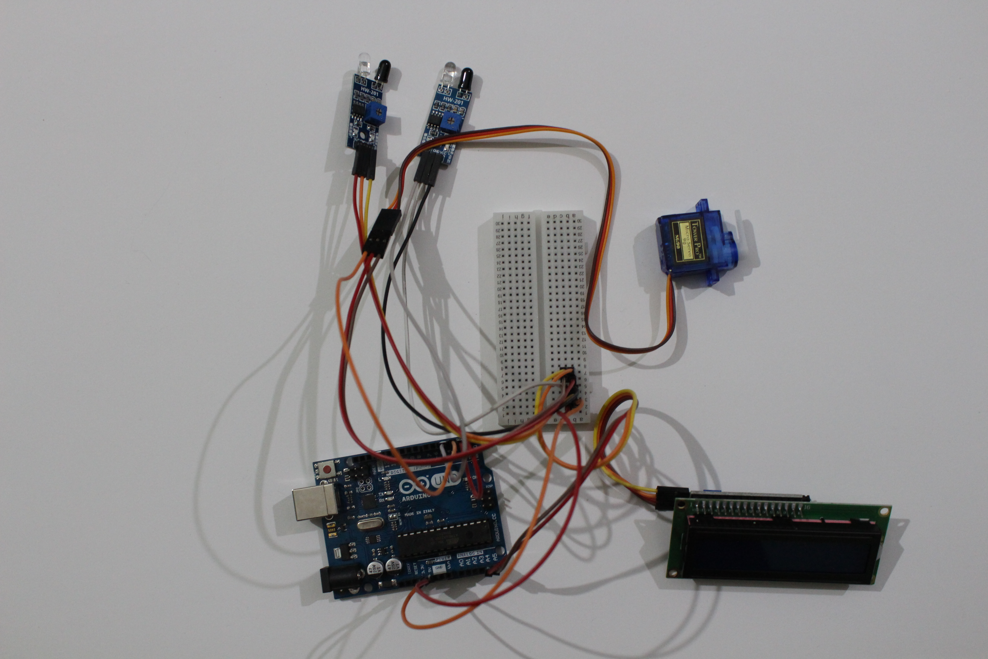
CONNECTION OF CIRCIUT

Slide 29
COST ANAYLISIS
COMPONENTS | PRICE
ARDUINO UNO BOARD | 600
BREAD BOARD | 196
JUMPER WIRE | 256
SERVO MOTOR | 250
IR PROXIMITY SENSORS | 250
16X2 LCD DISPLAY | 390
CRAFT MATERIALS | 350
TOTAL | 2292

Slide 30
C++
C++ is a powerful general-purpose programming language. It can be used to develop operating systems, browsers, games, and so on. C++ supports different ways of programming like procedural, object-oriented, functional, and so on. This makes C++ powerful as well as flexible.

Slide 31
Components of C++ used in code
Class()
When you define a class, you define a blueprint for a data type. This doesn't actually define any data, but it does define what the class name means, that is, what an object of the class will consist of and what operations can be performed on such an object. A class definition starts with the keyword class followed by the class name; and the class body, enclosed by a pair of curly braces.

Slide 32
.
If else statement
Without a conditional statement such as the if statement, programs would run almost the exact same way every time. If statements allow the flow of the program to be changed, and so they allow algorithms and more interesting code.

Slide 33
.
STRUCTURE:-Structure stores the different types of elements i.e heterogeneous elements. The struct keyword is used to define structure.​
UNION:-Union also stores the different types of elements i.e. heterogeneous elements. The union keyword is used to define structure. Union takes the memory of largest member only so occupies less memory than structures.

Slide 34
Software used
Fritzing ( for making circuit diagram)
Arduino IDE (for uploading codes to the board)
Visual code studios (compiler used for coding )
Adobe illustrator (for designing the blueprint)

Slide 35
Refrences
Youtube
fritzing.org
maker.pro

Slide 36
PRESENTATION 4 RESEARCH PAPER
/

Slide 37
Abstract
This article is about Automatic Parking System that contains the working information about the vehicle powered by microcontroller board. Everything in the modern world is going to automatic, we have built a system which can automatically sense the entry and exit of cars through the gate and then display the number of slots in the parking lot. This automated car parking system reduces the time taken to check the space for vehicles by displaying the available spaces for parking on a LCD display by using infrared (IR) proximity sensors installed at the entrance and exit. This project is developed using ARDUION UNO board.

Slide 38
INTRODUCTION
In the task Car Parking System, we've proved the idea of a computerized automobile parking machine. As with inside the cutting-edge global everything Goes computerized, we've constructed a machine if you want to automatically feel the access and go out of vehicles through the gate after which display the number of vehicles with inside the car-parking zone. Even we can set most four Potential of vehicles with the assist of consumer interface given with inside the hardware with inside the shape of switches in order that there may be no congestion. We have deployed a microcontroller that is used to feel the movement of vehicles and relying upon whether or not there may be a potential of vehicles to enter, it both free area is there or not. It is likewise liable to the free area whilst any automobile enters with inside the car-parking zone or near the door whilst Automobile exits from the car-parking zone. The sensing of access and go out of vehicles is carried out with the assist of Infrared transmitters and receivers. Before the door the Infrared transmitter is installed on one side and the receiver is located without delay in the front of the transmitter across the door. When an automobile arrives the Infrared beam is blocked through the auto and the receivers are without Infrared rays and its output changes. This trade in output is sensed through the microcontroller and consequently it increments the be counted number and opens the door if there may be a few potential. The technique for the go out of the vehicles is comparable as the access.....

Slide 39
WORKING PRINCIPLE
In our project automatic car parking system is working on the principle of IR Sensor i.e., we used 2 IR Sensor proximity, 16X2LCD i2c a servo motor and with help of some jumpers now make a circuit diagram connect with wire and follow all these steps we completed our car model.
So as we can see we have four slots on our parking system when the 1st IR sensor detects the car it opens the servo barrier and where the 2nd IR sensor detects the car it closes the barrier when the parking is filled it shows the message the parking is full when a car from inside comes out the 2nd IR sensor detects it opens the barrier and 1st IR sensor detects and again closes the barrier it means the car comes out and 1st slot is empty again this is how our model/system works.

Slide 40
ASSUMPTION
The objectives of the project were achieved and the assumption about the challenges associated with parking in a busy city was validated. A smart parking system will allow drivers to check for available parking spaces beforehand, they can pay for the parking fee, they can get electronic parking permits, and the city authority can get parking analytics for the city planning. We think that this is very helpful to reduce congestion and consumed our time.

Slide 41
FUTURE UPGRADES
We can use different types techniques in our smart parking system. Smart parking systems based on RFID technology. Wireless sensor networks based smart parking system. Smart parking systems based on Global Positioning Systems GPS.
Solar Energy
Today this system works on electricity, but in future we can connect solar panel, solar panel converts solar energy into electrical energy and system will be working on solar.]Apart from that another change in our parking system to develop charging stations. We should plant these charging stations in automatic parking stations which run on solar electrical power.
The future scope to adopt automatic Smart Parking System (SPS) so that availability of spaces could be displayed on a smart phone Application or even to satellite navigation device so that drivers will always aware of whether there are free spaces are not. And also enhance to send some notifications to users smart phone when vehicle enters to particular shopping places and some streets in a city etc.

Slide 42
CONCLUSION
Our project ensures to find free parking places for public. As soon as parking place is found to be empty it is detected using Ir sensor which reports it further. We achieved this by programming the sensors and Arduino. Pushing the data to webpage gives us tabular output which shows availability of parking places. The project aims at fast results so that anyone can easily find place for parking and save time in doing so. As Arduino is the latest technology, using it gives uniqueness to our project.

Slide 43
ACKNOWLEDGEMENT
This paper and the research behind it would not have been possible without the exceptional support of my team and our professor MR. SAMEER AGRAWAL, everyone contributed their enthusiasm, and knowledge and exacting attention to detail have been an inspiration and kept my work on track
On this project, we worked as both technical and electronics engineer. Under the technical part, we all do the coding simulation and illustrative word and in electronics part we did all the hardware related works, with true pleasure that I acknowledge the contributions of my amazing partner Sanket Satone, Priyanka kumari, Someshwar Ware and Ritik Raj who has given up many a precious to read every version of this paper.

Slide 44
REFERENCE
Suvarna S. Nandyal,Sabiya Sultana 's "Smart Car Parking System using Arduino UNO"International Journal of Computer Applications (0975 – 8887)
Volume 169 – No.1, July 2017
Mr. Kush Shah, Ms. Priya Chaudhari's "Arduino Based Smart Parking System"International Research Journal of Engineering and Technology (IRJET)
Volume: 04 Issue: 01 | Jan -2017
Mr. Vedant Chikhale, Mr. Raviraj Gharat, Ms. Shamika Gogate, Mr. Roshan Amireddy's, "Smart Car Parking Using Arduino Microcontroller"International Journal of New Technology and Research (IJNTR)
ISSN: 2454-4116, Volume-3, Issue-6, June 2017
S.Baskaran,D.Lakshmi,S.Benisha,R.Zahira"Arduino Based Intelligent Parking Assistance System"International Journal of ChemTech Research
CODEN (USA): IJCRGG, ISSN: 0974-4290,
Vol.11 No.04, pp 101-106, 2018.

Slide 45
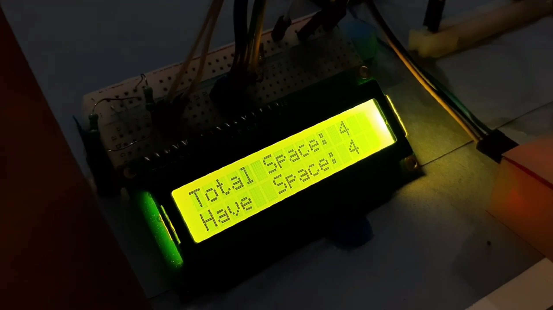
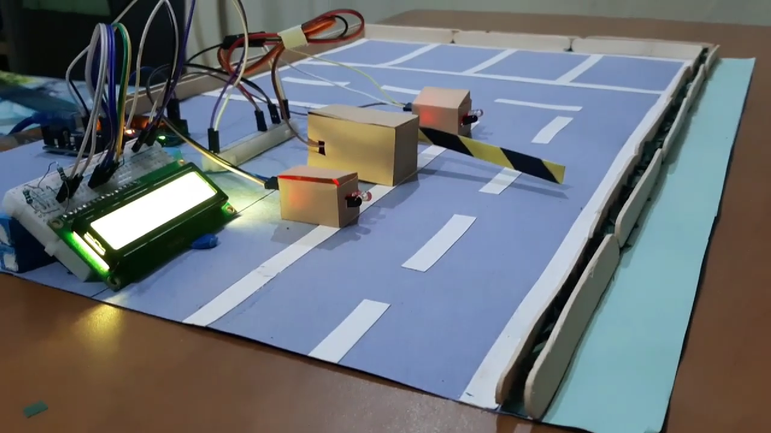
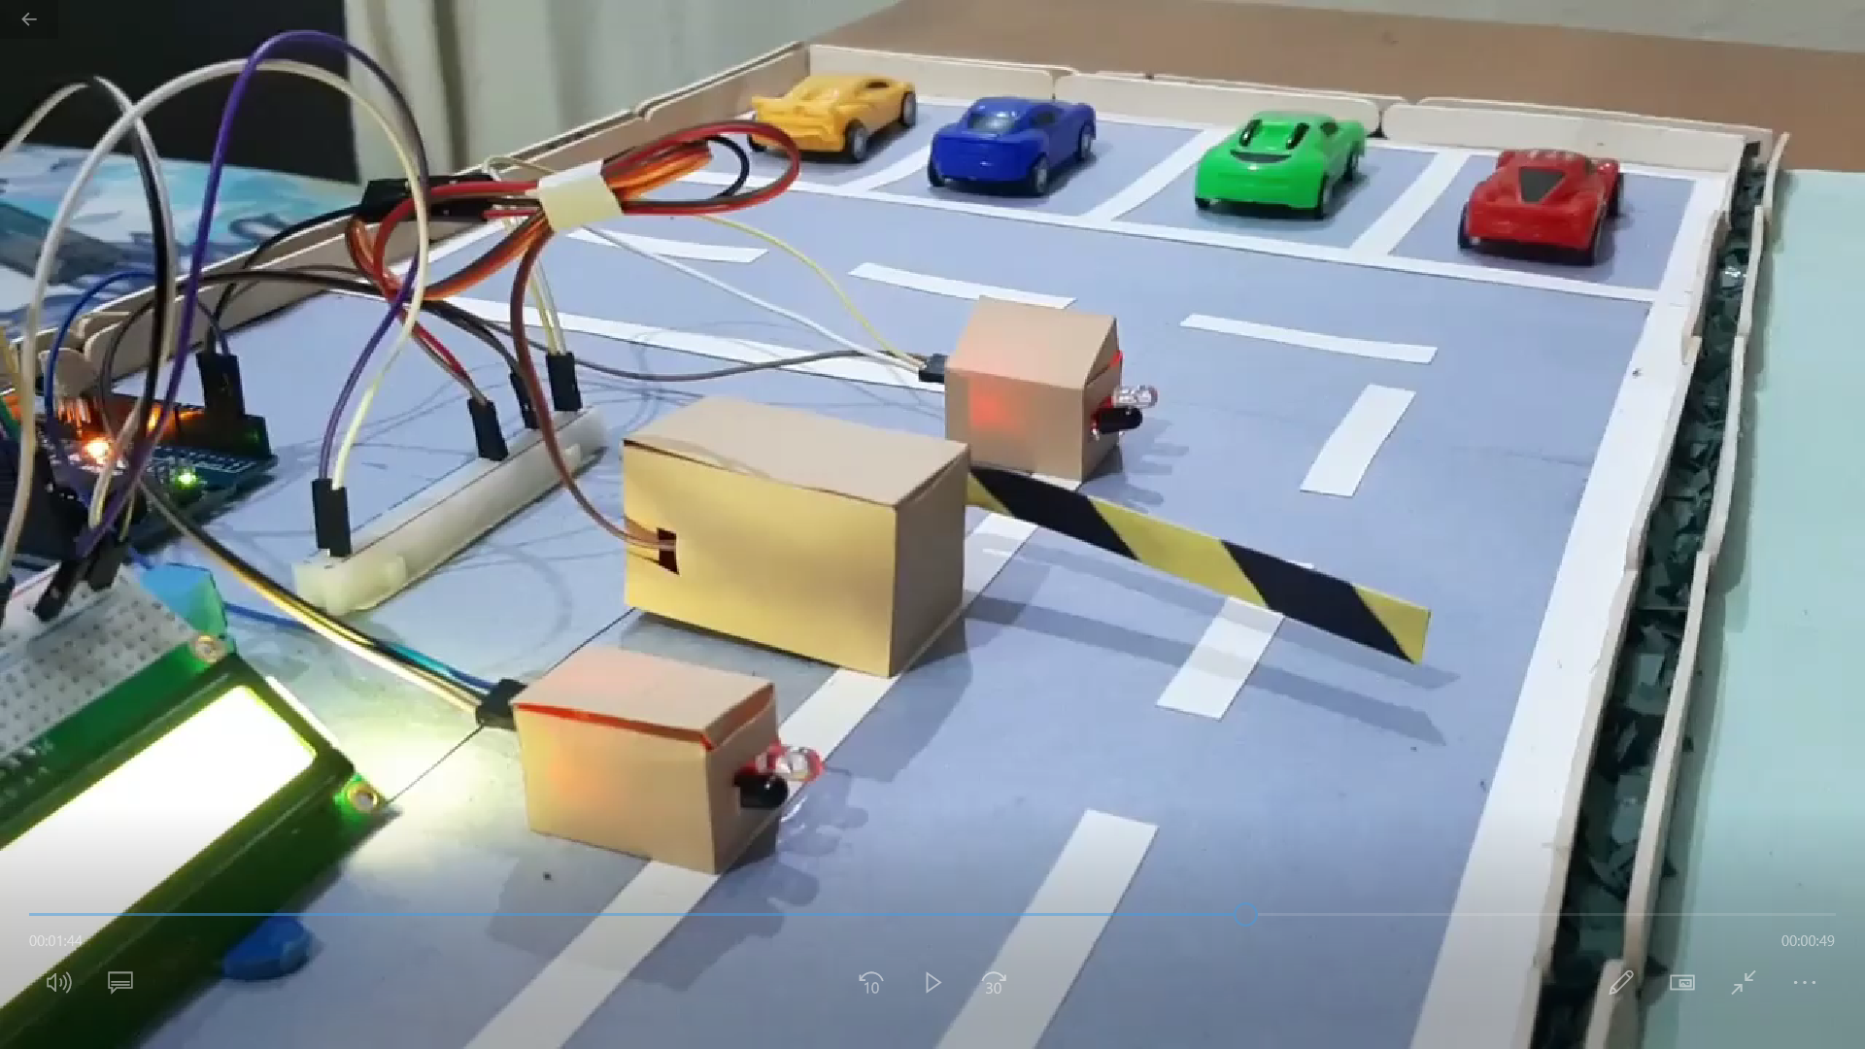
PROTOTYPE

Slide 46
Thank you

